Slide 1
Taxonomy of Communication Networks
Communication Network (CN) can be classified based on the way in which the nodes exchange information
Communication Network
Switched
CN
Broadcast
CN
Circuit-Switched
CN
Packet-Switched
CN
Datagram Network
Virtual Circuit Network

Slide 2
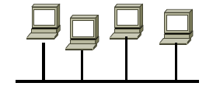
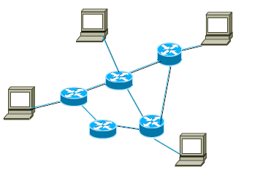
Broadcast Vs Switched Network
Broadcast networks
Information transmitted by any node is received by every node in the network
Ex: Broadcast Ethernet, wireless LANs
Need to coordinate the access to the shared medium
MAC
Switched networks
Links are point-to-point
Ex: WANs (Telephony Network, Internet)
Routing becomes harder

Slide 3
Switched Network
Switched Network is a series of interlinked nodes which are called switches
In a switched network, some switching nodes are connected to the end systems (like computers, telephones), others are used only for routing
Switching: Methods
Circuit switching
Packet switching
Datagram approach
Virtual circuit switched approach

Slide 4
Circuit Switched Network
Three phases in circuit switching
Establish
Transfer
Disconnect
The telephone message is not broken
It is sent all together
The message arrives in the same order as it was sent originally
Electronic signals pass through many switches before a connection is established (In modern circuit-switched networks)

Slide 5
Circuit Switched Network
During a call (transfer phase), switches can not be used by any other network traffic
Hence, the resources remain dedicated to the circuit during the entire transfer of data and the entire message follows the same path
A circuit-switched network is excellent for data that needs a constant link from end-to-end, for example, real-time video

Slide 6
Packet Switched Network
Packets are sent as soon as they are available
the message is broken into small data packets
Packet Switched network Approaches
Datagram Network Approach
Virtual Circuit Network Approach

Slide 7
Packet Switched Network
Datagram approach of packet switching
no need to set up a dedicated path in advance
It is up to routers to use store-and-forward transmission to send each packet on its way to the destination on its own
Packets seek out the most efficient route to travel as circuits become available
not necessarily the shortest route
There is no fixed path
Different packets can follow different paths
Packets may arrive out of order
It places a tight upper limit on the size of packets
This ensures that no user can monopolize any transmission line for very long (e.g., many milliseconds)
Thus, it can handle interactive traffic

Slide 8
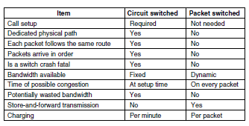
A comparison of circuit switched and Datagram packet switched networks

Slide 9
In Circuit and Packet Switched Network
The trade-off is between guaranteed service and wasting resources versus not guaranteeing service and not wasting resources

Slide 10
Virtual Circuit Network
A cross between a circuit-switched network and a datagram network
As in a circuit-switched network
It has setup and teardown phases in addition to the data transfer phase
A virtual circuit is made before actual data is transmitted but it is different from circuit switching in a sense that
in circuit switching the call accept signal comes only from the final destination to the source
while in case of virtual-packet switching this call accept signal is transmitted between each adjacent intermediate node.
all packets follow the same path established during the connection

Slide 11
Virtual Circuit Network
In virtual-circuit packet switching
An initial setup phase is used to set up a route between the intermediate nodes for all the packets passed during the session between the two end nodes.
In each intermediate node, an entry is registered in a table to indicate the route for the connection that has been set up.
Thus, packets passed through this route, can have short headers, containing only a virtual circuit identifier (VCI), and not their destination.
This approach is slower than Circuit Switching, since different virtual circuits may compete over the same resources, and an initial setup phase is needed to initiate the circuit.

Slide 12
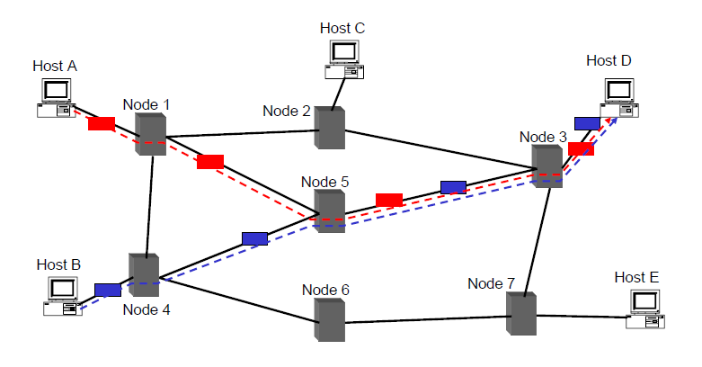
Virtual Circuits guarantees that all packets in a flow follow one path

Slide 13
INTERNET (in reality)
is a datagram network
BUT part of the Internet uses circuit-switching (Phone links) or virtual circuit (ATM)

